Slide 1
Single Table Queries
Week 2 Chapter 4 Video 2
Formatting your SQL Query
Dr. Anne Powell

Slide 2
Agenda
1. Basic SELECT commands
2. Column Formatting
3. Common Errors
4. DISTINCT – WHERE commands
5. ORDER BY command
6. In-class practice

Slide 3
Column-Format Command
Use this command to format the output display of column data by resizing the width of columns where output will not fit within a column and wraps around, or by specifying a formatting template.

Slide 4
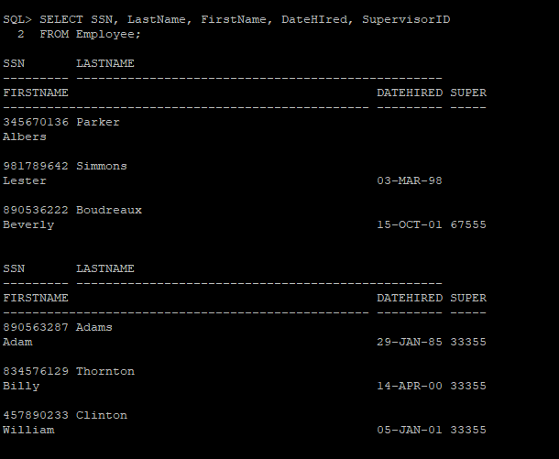
Without Formatting

Slide 5
Column-Format Example #1 – Preventing Wrap Around Lines
/* SQL Example */
COLUMN SSN FORMAT A9;
COLUMN LastName FORMAT A11;
COLUMN FirstName FORMAT A11;
COLUMN SupervisorID FORMAT A12;
SELECT SSN, LastName, FirstName, DateHired, SupervisorID
FROM Employee;
SSN LASTNAME FIRSTNAME DATEHIRED SUPERVISORID
--------- ----------- ---------- --------- ------------
981789642 Simmons Lester 03-MAR-98
890536222 Boudreaux Beverly 15-OCT-01 67555
890563287 Adams Adam 29-JAN-85 33355
more rows will be displayed…

Slide 6
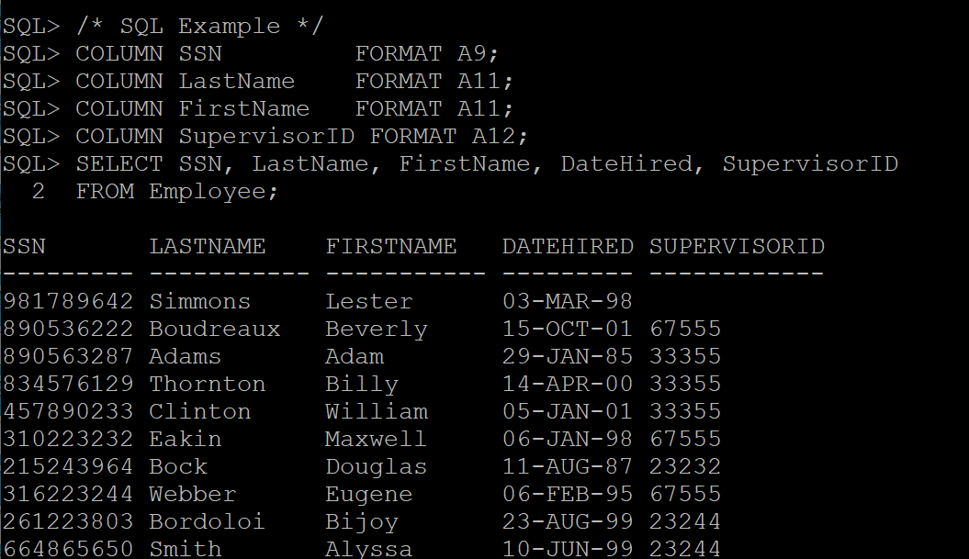
With Formatting
More rows would follow …

Slide 7
Column-Format Example #2 – Formatting Numeric Columns
/* SQL Example */
COLUMN Salary FORMAT 99999.99;
SELECT Salary
FROM Employee;
SALARY
---------
22000.00
17520.00
5500.00
more rows will be displayed…

Slide 8
Column-Format Example #3 – Formatting with a Currency Symbol
/* SQL Example */
COLUMN Salary FORMAT $99,999.99;
SELECT Salary
FROM Employee;
SALARY
-----------
$22,000.00
$17,520.00
$5,500.00
more rows will be displayed…

